Slide 1


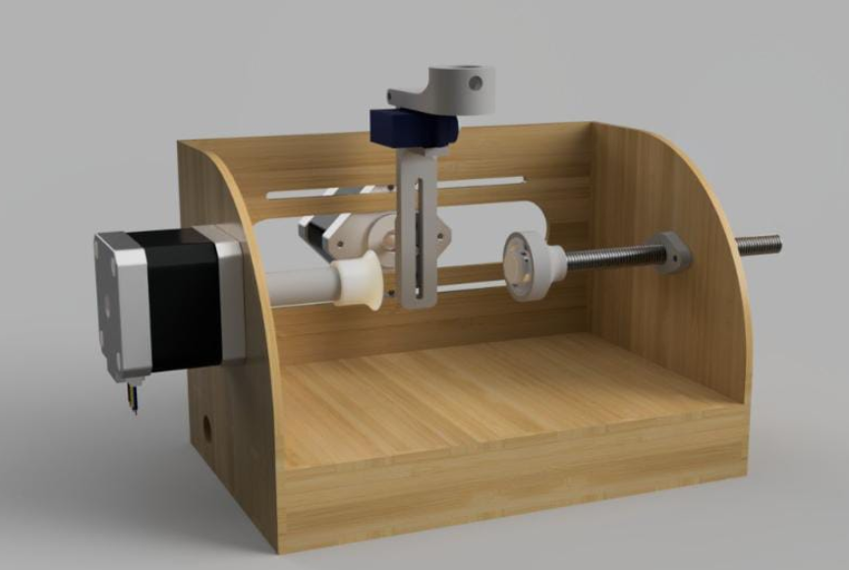
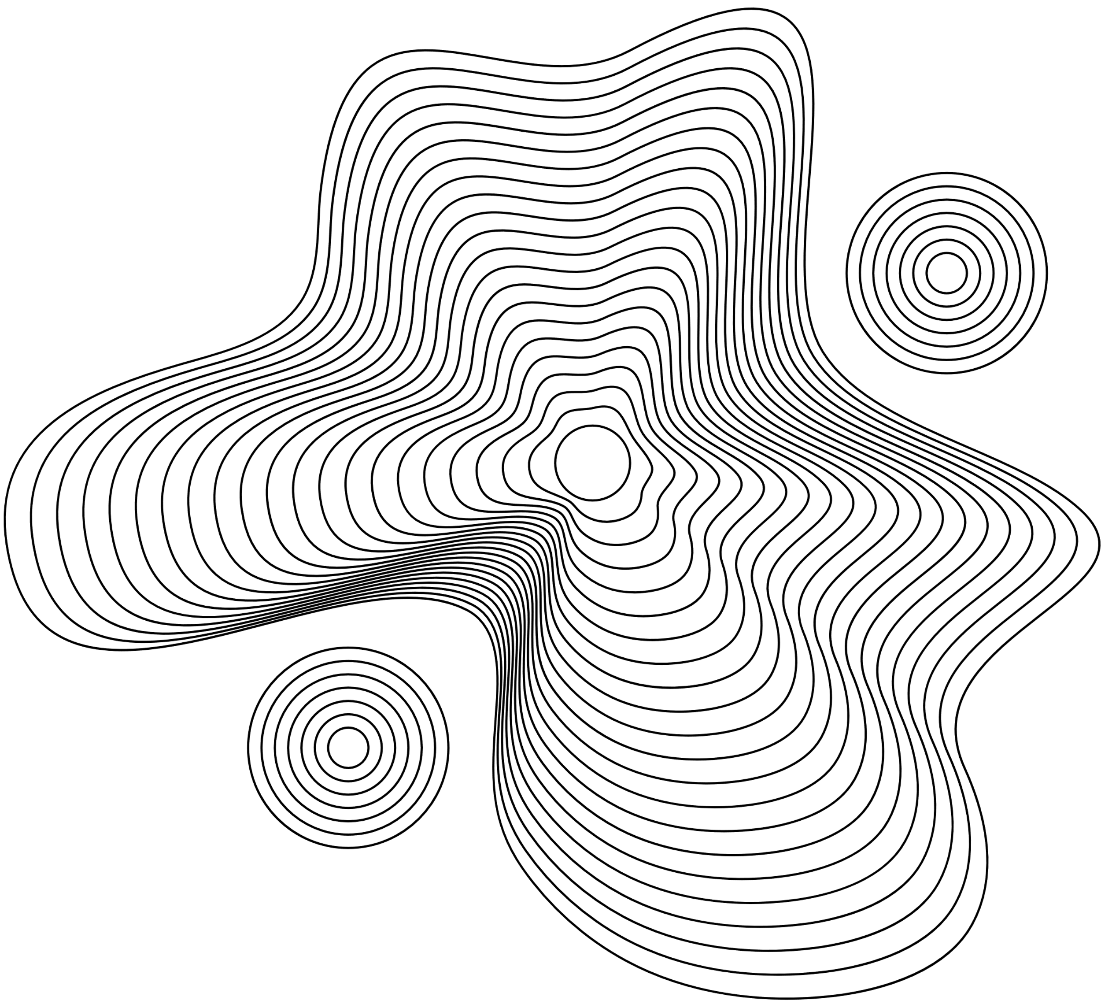
CNC Machine
Engraving, Laser cutting, Printing, Drawing
Abdul-Haseeb
computer03361@gmail.com

Slide 2
About
What is a CNC Machine, and what is its main purpose?
Which three components does a CNC Machine project combine?
CNC Machine is a robotic machine that automates drawing or cutting using computer-generated code.
It combines electronics, mechanical components, and software.
Why is the CNC Machine considered both educational and practical?
The CNC Machine is considered both educational and practical because it teaches students about electronics, mechanical systems, and programming in a hands-on way. It helps in understanding automation through real components like motors and microcontrollers. It can be used practically for tasks like drawing, engraving, and cutting with high accuracy. This makes it useful in both learning environments and small-scale production.

Slide 3
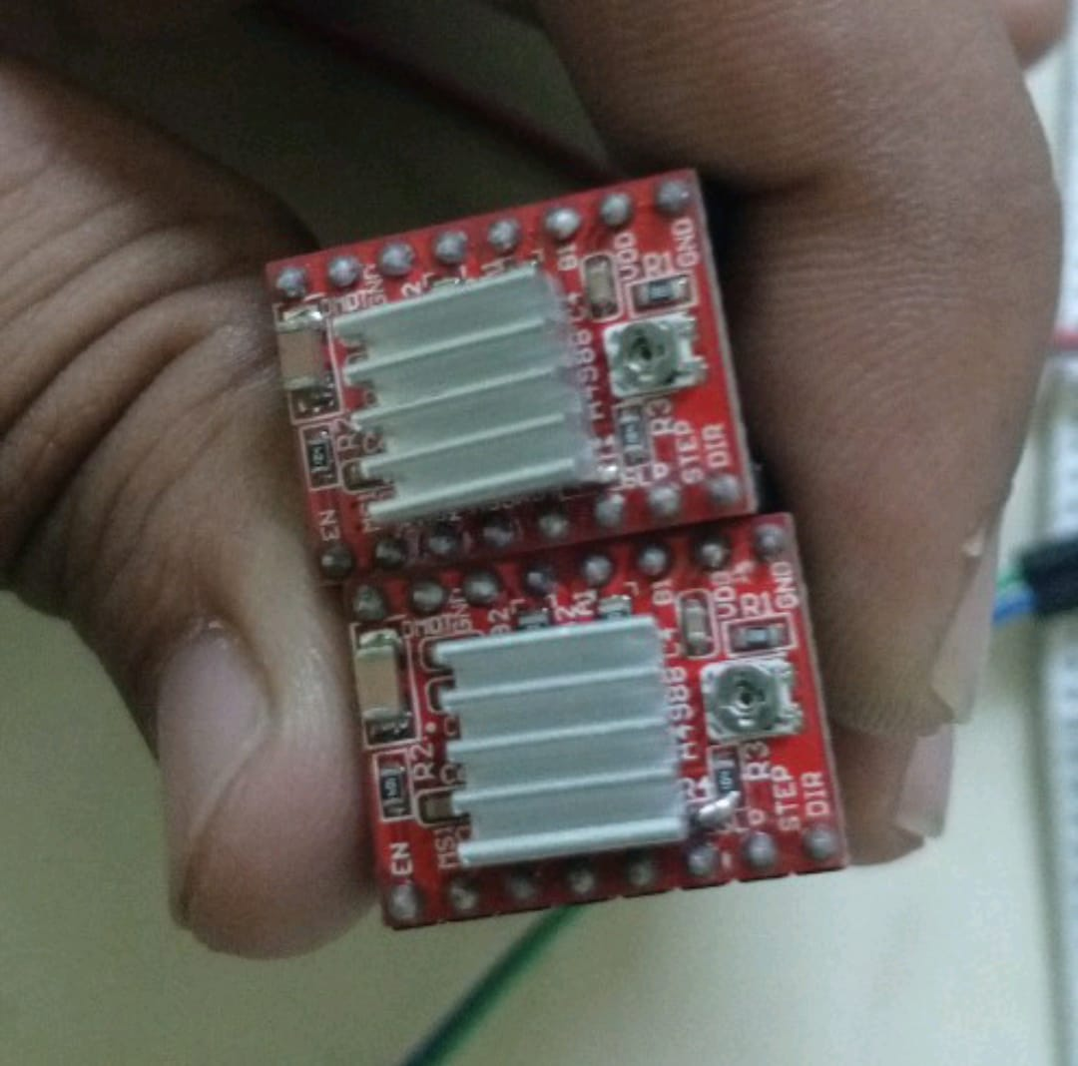
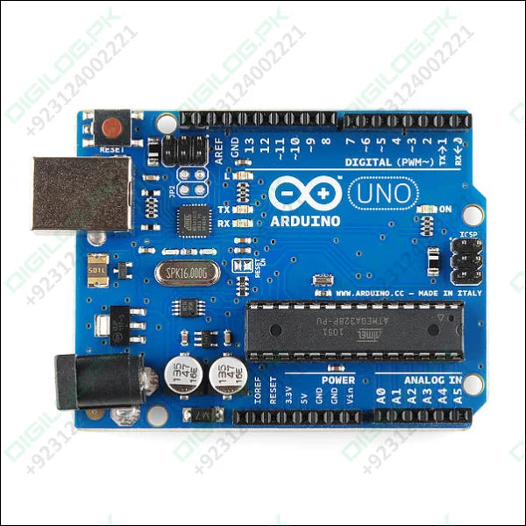
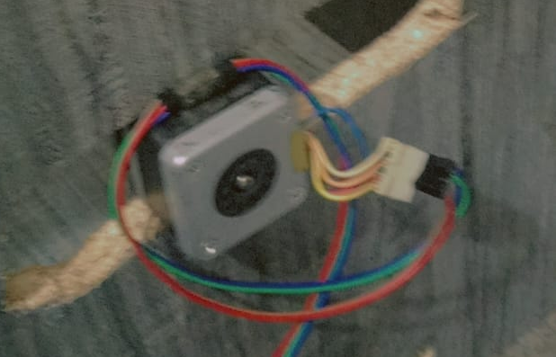
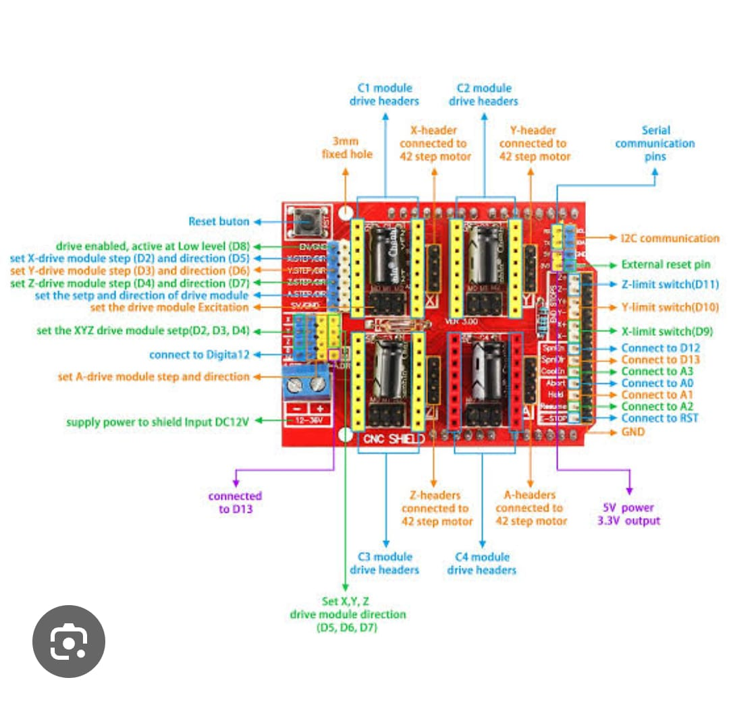
Components Working
A CNC Machine works by receiving computer-generated code (G-code) that controls its movements. Stepper motors move the pen or tool along the X and Y axes to draw or cut shapes. A microcontroller like Arduino processes the code and controls the hardware precisely.
Key Components of CNC Machine
Arduino UNO (main controller)
Stepper Motors (NEMA 17) for X and Y movement
Servo Motor for pen up/down on Z-axis
CNC Shield and Drivers (A4988)
Mechanical frame (rods, bearings)
Software and Tools Used
Inkscape for design creation (SVG format)
JS Cut to convert SVG into G-code
CNC.js to control machine and send G-code
Pen GRBL and Servo GRBL firmware
Working Mechanism
Create a design in Inkscape
Convert design to G-code using JS Cut
Upload G-code into CNC.js interface
Arduino reads the G-code and moves motors accordingly
Servo lifts and drops the pen for Z-axis

Slide 4
Manual Drawing vs CNC Machine
Manual drawing requires human effort and is error-prone
CNC plotter is automated and accurate
Consistency, speed, and precision are higher in CNC plotter
Automation in Design
CNC plotters represent a shift toward automation in art and engineering
Students and engineers can create complex designs without manual tools
Enhances learning and creativity
Applications of CNC Machine
PCB design
Artistic drawing
Laser engraving (with minor modifications)
Educational demonstrations
Why?
A CNC Machine is used because it automates drawing and cutting with high precision and speed. It helps save time and effort compared to manual work and produces consistent, accurate results. It’s useful for learning automation and for practical tasks like designing and engraving.

Slide 5

Benefits of CNC Machine
High Precision: Produces accurate and detailed designs.
Time-Saving: : Works faster than manual drawing or cutting.
Automation: Runs on computer code with minimal human effort.
Consistency: Repeats the same task without errors.
Educational Value: Helps learn electronics, coding, and mechanics.
Multi-purpose: Can be used for drawing, engraving, cutting, etc.
Cost-Effective: Useful for small-scale production and DIY projects.

Slide 6







Proper calibration required
challenges
The machine must be accurately calibrated to ensure precise movements and outputs.
Getting a CNC Machine to work smoothly can be tricky. Calibrating motors for perfect precision takes patience and testing. Some materials slip or tear, making clean plotting a challenge. Software errors or shaky mechanics can ruin hours of work.
Complex designs need optimized G-code
Advanced drawings require well-structured G-code for smooth and error-free execution.
Hardware like servo/motors may require tuning
Motors may need speed and position adjustments for reliable performance.
Power supply must be stable
A consistent power source is essential to avoid interruptions or damage to components.

Slide 7


Role of Technology in CNC Machine
Open-source software and libraries support CNC systems
GRBL firmware allows Arduino to read G-code
Inkscape and JS Cut enable easy design-to-G-code conversion
USB connection enables PC-to-Arduino control
User-Friendly Digital Platforms
Convenient Mobile Applications
Secure and Fast Payment Systems

Slide 8

Future of CNC Machine Technology
Integration with AI for intelligent drawing
Use of stronger motors for 3D plotting
Educational kits becoming more accessible
Support for laser, cutter, and print heads
Budgeting Skills
Developing a budget allows gig workers to track income and expenses, ensuring they live within their means.
Investment Awareness
Understanding investment options can help gig workers grow their savings and prepare for future financial goals.

Slide 9


How to Build a CNC Machine Successfully
Understand G-code basics
Use quality motors and rods for smooth movement
Test firmware and software compatibility
Start with simple designs and expand gradually
Budget Planning for CNC Machine
Use affordable components: Arduino UNO, A4988,basic frame materials
Free software: Inkscape, JS Cut, CNC.js
Keep cost under control while maintaining quality

Slide 10

Conclusion
CNC Machine is a great DIY project combining software, electronics, and mechanical parts.
Students gain real-world knowledge of automation.
Affordable, scalable, and educational.

Slide 11

Thank You

